Slide 1
KT session Overview Agenda- KT to new Joiners for Testing terminologies
Dated- 08th Aug, 2022
By: Himanshu Jindal

Slide 2
Points Covered in the session
Software testing and What is bug, Error and Failure
Types of software testing
Manual Testing and it’s types (White Box testing, Black box and Gray testing)
Functional and Non-Functional testing
Types of Functional Testing i.e. Unit testing, integration testing and System Testing
Types of non-Functional testing (Performance, Usability, Compatibility)
Some other types of software testing (Sanity, UAT, Ad hoc Testing)
Defect/ Bug life cycle
Terminologies for Bug Life Cycle
Defect report
Severity and Priority
Important field in Defect report
Test Case design
Test Case review
Test execution
Software Testing Terminology

Slide 3
Software testing
Software testing is a process of analyzing an application's functionality as per the customer prerequisite.
If we want to ensure that our software is bug-free or stable, we must perform the various types of software testing because testing is the only method that makes our application bug-free.
What is a bug?
In software testing, a bug is the informal name of defects, which means that software or application is not working as per the requirement. When we have some coding error, it leads a program to its breakdown, which is known as a bug. The test engineers use the terminology Bug.

Slide 4
What is a Defect?
When the application is not working as per the requirement is knows as defects. It is specified as the aberration from the actual and expected result of the application or software.
In other words, we can say that the bug announced by the programmer and inside the code is called a Defect.
What is Error?
The Problem in code leads to errors, which means that a mistake can occur due to the developer's coding error as the developer misunderstood the requirement or the requirement was not defined correctly. The developers use the term error.

Slide 5
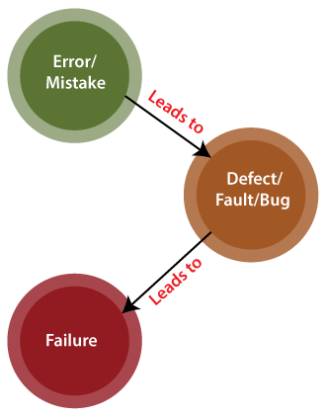
Pictorial view of Error/ bug and Defect

Slide 6
What is Fault?
The fault may occur in software because it has not added the code for fault tolerance, making an application act up.
What is Failure?
Many defects lead to the software's failure, which means that a loss specifies a fatal issue in software/ application or in its module, which makes the system unresponsive or broken.
In other words, we can say that if an end-user detects an issue in the product, then that particular issue is called a failure.
Possibilities are there one defect that might lead to one failure or several failures.
For example, in a bank application if the Amount Transfer module is not working for end-users when the end-user tries to transfer money, submit button is not working. Hence, this is a failure.

Slide 7
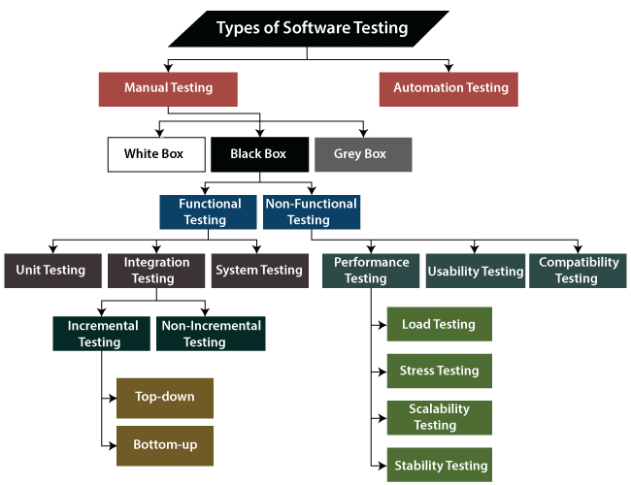
Types of Software testing

Slide 8
What is Manual testing
Testing any software or an application according to the client's needs without using any automation tool is known as manual testing.
In other words, we can say that it is a procedure of verification and validation. Manual testing is used to verify the behavior of an application or software in contradiction of requirements specification.
In software testing, manual testing can be further classified into three different types of testing, which are as follows:
White Box Testing
Black Box Testing
Grey Box Testing

Slide 9
White Box testing
White Box Testing
In white-box testing, the developer will inspect every line of code before handing it over to the testing team or the concerned test engineers.
Subsequently, the code is noticeable for developers throughout testing; that's why this process is known as WBT (White Box Testing).
In other words, we can say that the developer will execute the complete white-box testing for the particular software and send the specific application to the testing team.
The purpose of implementing the white box testing is to emphasize the flow of inputs and outputs over the software and enhance the security of an application.

Slide 10
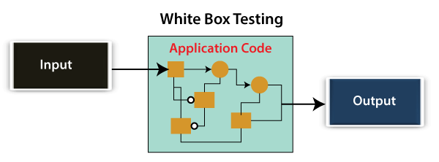
White box testing is also known as open box testing, glass box testing, structural testing, clear box testing, and transparent box testing.

Slide 11
Black Box Testing
Another type of manual testing is black-box testing. In this testing, the test engineer will analyze the software against requirements, identify the defects or bug, and sends it back to the development team.
Then, the developers will fix those defects, do one round of White box testing, and send it to the testing team for retesting.
Here, fixing the bugs means the defect is resolved, and the particular feature is working according to the given requirement.
The main objective of implementing the black box testing is to specify the business needs or the customer's requirements.
In other words, we can say that black box testing is a process of checking the functionality of an application as per the customer requirement. The source code is not visible in this testing; that's why it is known as black-box testing.

Slide 12
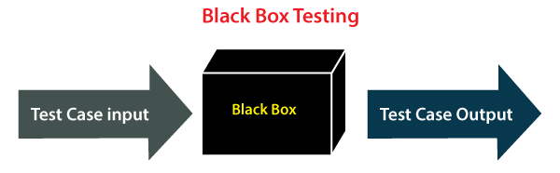
Black Box Testing

Slide 13
Types of Black Box Testing
Black box testing further categorizes into two parts, which are as discussed below:
Functional Testing
Non-function Testing
Functional Testing
The test engineer will check all the components systematically against requirement specifications is known as functional testing. Functional testing is also known as Component testing.
In functional testing, all the components are tested by giving the value, defining the output, and validating the actual output with the expected value.
Functional testing is a part of black-box testing as its emphases on application requirement rather than actual code. The test engineer has to test only the program instead of the system.

Slide 14
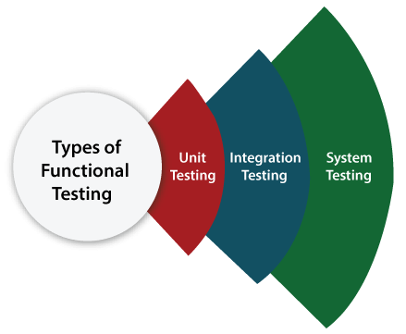
Types of Functional Testing
Just like another type of testing is divided into several parts, functional testing is also classified into various categories.
The diverse types of Functional Testing contain the following:
Unit Testing
Integration Testing
System Testing

Slide 15
Unit Testing
Unit testing is the first level of functional testing in order to test any software/ functionality. In this, the test engineer will test the module of an application independently or test all the module functionality is called unit testing.
The primary objective of executing the unit testing is to confirm the unit components with their performance. Here, a unit is defined as a single testable function of a software or an application. And it is verified throughout the specified application development phase.
Integration Testing
Once we are successfully implementing the unit testing, we will go integration testing
. It is the second level of functional testing, where we test the data flow between dependent modules or interface between two features is called integration testing.
The purpose of executing the integration testing is to test the statement's accuracy between each module.

Slide 16
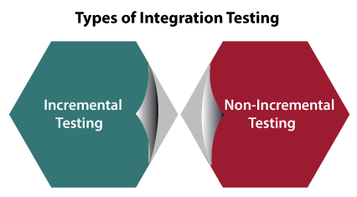
Types of Integration Testing
Integration testing is also further divided into the following parts:
Incremental Testing
Non-Incremental Testing
Incremental Integration Testing
Whenever there is a clear relationship between modules, we go for incremental integration testing. Suppose, we take two modules and analysis the data flow between them if they are working fine or not.
If these modules are working fine, then we can add one more module and test again. And we can continue with the same process to get better results.
In other words, we can say that incrementally adding up the modules and test the data flow between the modules is known as Incremental integration testing.

Slide 17
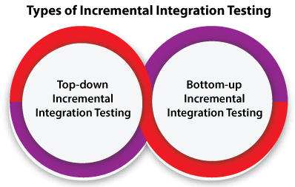
Types of Incremental Integration Testing
Incremental integration testing can further classify into two parts, which are as follows:
Top-down Incremental Integration Testing
Bottom-up Incremental Integration Testing
1. Top-down Incremental Integration Testing
In this approach, we will add the modules step by step or incrementally and test the data flow between them. We have to ensure that the modules we are adding are the child of the earlier ones.
2. Bottom-up Incremental Integration Testing
In the bottom-up approach, we will add the modules incrementally and check the data flow between modules. And also, ensure that the module we are adding is the parent of the earlier ones.

Slide 18
Non-Incremental Integration Testing/ Big Bang Method
Whenever the data flow is complex and very difficult to classify a parent and a child, we will go for the non-incremental integration approach. The non-incremental method is also known as the Big Bang method.
System Testing
Whenever we are done with the unit and integration testing, we can proceed with the system testing.
In system testing, the test environment is parallel to the production environment. It is also known as end-to-end testing.
In this type of testing, we will undergo each attribute of the software and test if the end feature works according to the business requirement. And analysis the software product as a complete system.

Slide 19
Non-function Testing
The next part of black-box testing is non-functional testing. It provides detailed information on software product performance and used technologies.
Non-functional testing will help us minimize the risk of production and related costs of the software.
Non-functional testing is a combination of performance, load, stress, usability and, compatibility testing.
Types of Non-functional Testing
Non-functional testing categorized into different parts of testing, which we are going to discuss further:
Performance Testing
Usability Testing
Compatibility Testing

Slide 20
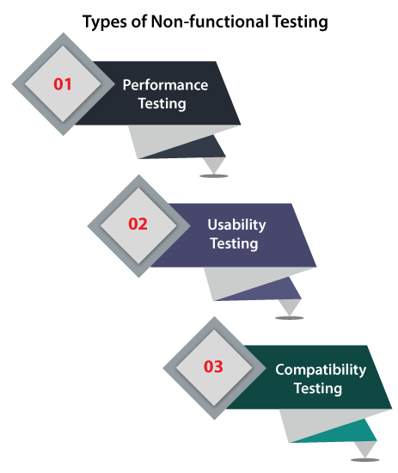
Types of non Functional testing

Slide 21
Performance Testing
In performance testing, the test engineer will test the working of an application by applying some load.
In this type of non-functional testing, the test engineer will only focus on several aspects, such as Response time, Load, scalability, and Stability of the software or an application.
Classification of Performance Testing
Performance testing includes the various types of testing, which are as follows:
Load Testing
Stress Testing
Scalability Testing
Stability Testing

Slide 22
Load Testing | While executing the performance testing, we will apply some load on the particular application to check the application's performance, known as load testing. Here, the load could be less than or equal to the desired load.
Stress Testing | It is used to analyze the user-friendliness and robustness of the software beyond the common functional limits.
Scalability Testing | To analysis, the application's performance by enhancing or reducing the load in particular balances is known as scalability testing.
Stability Testing | Stability testing is a procedure where we evaluate the application's performance by applying the load for a precise time.
Usability Testing | Another type of non-functional testing is usability testing. In usability testing, we will analyze the user-friendliness of an application and detect the bugs in the software's end-user interface. Here, the term user-friendliness defines the following aspects of an application: The application should be easy to understand, which means that all the features must be visible to end-users. The application's look and feel should be good that means the application should be pleasant looking and make a feel to the end-user to use it.
Compatibility testing | In compatibility testing, we will check the functionality of an application in specific hardware and software environments. Once the application is functionally stable then only, we go for compatibility testing.

Slide 23
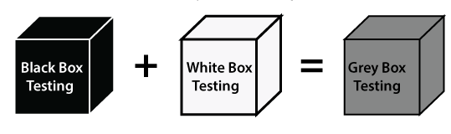
Grey Box Testing
Another part of manual testing is Grey box testing. It is a collaboration of black box and white box testing.
Since, the grey box testing includes access to internal coding for designing test cases. Grey box testing is performed by a person who knows coding as well as testing.
In other words, we can say that if a single-person team done both white box and black-box testing, it is considered grey box testing.

Slide 24
Some other types of Software Testing
In software testing, we also have some other types of testing that are not part of any above discussed testing, but those testing are required while testing any software or an application.
Smoke Testing
Sanity Testing
Regression Testing
User Acceptance Testing
Exploratory Testing
Adhoc Testing
Security Testing
Globalization Testing

Slide 25
Defect/Bug Life Cycle
Defect Life Cycle:
Defect life cycle, also known as Bug Life cycle is the journey of a defect cycle, which a defect goes through during its lifetime.
It varies from organization to organization and also from project to project as it is governed by the software testing process and also depends upon the tools used.
Defect Life Cycle is a cyclic process, which describes how a defect or bug passes through different stages from the identification stage to the Fixing stage. it begins when a tester finds or logs a bug, and it ends when the bug is fixed.
If Developer reject a defect understand the reason why defect is rejected , if developer is correct, we can close the defect or else we can discuss it with test lead or project lead and than reopen the defect.

Slide 26
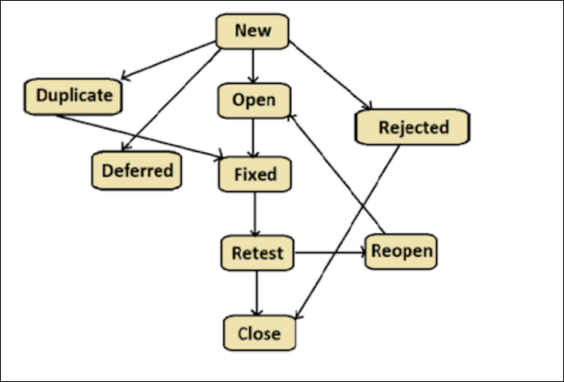
Bug life cycle

Slide 27
Terminologies for Bug life Cycle
Some of the familiar values used for defects, during their life cycle are :
New : New defect is reported.
Open : The developer is currently working on the defect.
Fixed : The code changes are completed and the defect is resolved .
Deferred : Developers will fixed the defect later.
Duplicate : The defect is same like one of the previous defect. When previous is fixed it also fixed.
Retest : the tester starts the task of retesting the defect to verify if the defect is fixed or not.
Rejected : Developers did not accept the defect .
Close : After re test if defect is working correctly .
Reopen : After re test if defect is still exist then we reopen the defect.
Not a Bug : If the defect does not have an impact on the functionality of the application, then the status of the defect gets changed to “Not a Bug”.
There are others of course, and some groups might use combinations of these values (such as Closed-Fixed, Closed-WontFix, etc.).

Slide 28
Defect Report | Priority and Severity
Defect Report:
If application is not working as expected we can report that as defect in defect report.
A defect report is a document that has concise details about what defects are identified, what action steps make the defects show up, and what are the expected results instead of the application showing error (defect) while taking step by step actions.
Defect Reporting, Defect Tracking, and Status Tracking is called Defect Management. Some companies use Manual Process (Excel workbook), and some companies use Tool-based processes for Defect Management.
Defect Management Tools Examples: Bugzilla / Issue-Tracker / PR-Tracker etc.

Slide 29
Important fields of a Defect Report template:
Defect Id : It is a unique number for every defect we found while testing.
Summary : Full description of the defect .
Detected By : Name of the tester who found the defect .
Assigned to : Currently the defect is assigned to whom. When a tester found a defect the it has to assign to any developer.
Severity : Severity defines how impactful a bug can be to the system. It can value either high or medium or low specifies the seriousness of the defect.
Priority : Priority indicates how soon the bug should be fixed. It can value either high or medium or low specifies the importance of the defect or functionality. The defect are fixed based on priorities .

Slide 30
Important fields of a Defect Report template:
Status: Defect Status in defect life cycle is the present state from which the defect or a bug is currently undergoing. The goal of defect status is to precisely convey the current state or progress of a defect in order to better track and understand the actual progress of the defect lifecycle.
Build version : It show currently build version in which we are testing. We can check this from release note document.
Module: In which module the defect is found.
Environment: The defect is found in which environment like : Test environment, UAT or Production environment.
Defect Type : Specify the type of defect like functional , network , data , performance or UI ( User Interface) etc.
Reproduceable: It has value either YES or NO:
YES: Every time the defect is occurring . NO: Most of the time its working correctly, only few cases it is failing and not able to reproduce ( If the defect is non reproduceable we can take screen shot of the defect and report it along with the defect.)
Reproduce Steps : Specify the navigation steps to reproduce the defect.

Slide 31
Test Case Design
Test case design refers to how you set-up your test cases. It is important that your tests are designed well, or you could fail to identify bugs and defects in your software during testing.
It is responsibility of a tester to design the test cases.
To design the test cases tester should :
Understand the requirement
Identify the scenario
Design the test case
Get is reviewed the test case
Update the test case based on review

Slide 32
How to create good test cases
Test Cases need to be simple steps, transparent and easy to understand.
Each and every test case should be traceable and it should be linked to “Requirement ID”.
Test cases should have only necessary and valid steps (Brief And Short) .
Implement Testing Techniques – Positive And Negative Test Cases
Test cases should be written in such a way that it should be easy to maintain.
Test cases should cover the usability aspects in terms of ease of use.
Different set of test cases should be prepared for the basic performance testing like multi-user operations and capacity testing.
Test cases for Security aspects should be cover for example user permission, session management, logging methods.

Slide 33
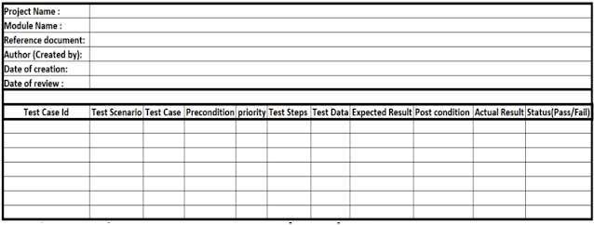
Test case Design Format

Slide 34
Follow below steps to create Test cases
Test Case Id : It is a unique number to represent each test cases. It’s good practice to follow some naming convention for better understanding and discrimination purposes. Like Tc_proj_module_number(001)
For example: Tc_Yahoo_Inbox_001
Test Scenario : A Test Scenario is defined as any functionality that can be tested. It is a collective set of test cases which helps the testing team to determine the positive and negative characteristics of the project. Test Scenarios are derived from test documents such as BRS and SRS.
Test Cases : A Test Case is a set of actions executed to verify a particular feature or functionality of your application. Test Cases are focused on what to test and how to test. Test Case is mostly derived from test scenarios.
Precondition : The condition to be satisfied to test the requirement. Conditions that need to meet before executing the test case.
Priority : The importance of the test case is called priority. It is a parameter to decide the order in which defects should be fixed. Priority means how fast defect has to be fixed.
Test Steps : Test Steps describe the execution steps. To execute test cases, you need to perform some actions. Each step is marked pass or fail based on the comparison result between the expected and actual outcome.
Test Data: It is data created or selected to satisfy the execution preconditions and inputs to execute one or more test cases. We need proper test data to execute the test steps.
Expected result : The output result as per customer requirement (As per SRS or FRS). The result which we expect once the test cases were executed.
Post Condition : Conditions that need to achieve when the test case was successfully executed.
Actual Result : The output result in the application once the test case was executed. Capture the result after the execution. Based on this result and the expected result, we set the status of the test case.
Status : The status as Pass or Fail based on the expected result against the actual result. If the actual and expected results are the same, mention it as Passed. Else make it as Failed. If a test fails, it has to go through the bug life cycle to be fixed.

Slide 35
Other important fields of a test case template:
Project Name: Name of the project the test cases belong to.
Module Name: Name of the module the test cases belong to.
Reference Document: Mention the path of the reference documents (if any such as Requirement Document, Test Plan , Test Scenarios, etc.,)
Author (Created By) : Name of the Tester who created the test cases.
Date of Creation: When the test cases were created.
Date of Review: When the test cases were reviewed.
Reviewed By: Name of the Tester who created the test cases.
Executed By: Name of the Tester who executed the test case.
Date of Execution: When the test case was executed.
Comments: Include value information which helps the team.

Slide 36
Test Case Review Process and Guidelines
Test Case Review :
Test case review process is an important process to follow in software testing. Test case should be effective and follow the standards to write test case.
After preparation of the test cases review are conduct to ensure the completeness and correctness of the test case, proper flow, and maximum test coverage.
The test lead or project manager have to approve the test cases.
During this review process, if the reviewer found any mistake, he/she writes it in a separate document, which is known as Review document and sends it back to the author.
Test Case Review Techniques :
Self-review: This is carried out by the tester who wrote the test cases. By looking at SRS/FRD, he/she can see if all of the requirements are met or not.
Peer review: Before test lead the test cases reviewed by another team member who is not familiar with the system is called peer review. Maker and Checker are two other names for the same thing.
Supervisory review: This is done by a team lead or project manager who is higher in rank than the tester who wrote the test cases and has an extensive understanding of the requirements and system.

Slide 37
Common mistakes which are check during Test Case Review :
Incomplete Test Cases. Missing negative test cases. No Test Data. Inappropriate/Incorrect Test data.
Spelling errors can sometimes cause a lot of confusion or make a statement difficult to grasp.
While review process, it is very important to check whether all the standards and guideline are properly followed.
If proper template is followed then it becomes easy to add/modify test cases in future and test case plan looks organized.
If the grammar is incorrect, the test case can be misinterpreted, leading to incorrect findings.
Test cases should have a very simple language which is easy to understand.
Replication: It refers to the duplicate test cases removal. It is possible that two or more test cases test the same thing and can be merged into one, this would save time and space.
Test case which are uselessness due to change in requirements or some modifications. Such test cases must be removed.

Slide 38
Test Case Repository :
A test case repository is a centralized location where all the baseline test cases (written, review, and approved) are stored.
Test repository comprises test cases that encompass all key possibilities of permutations and combinations in workflow execution and transaction, ensuring that all variations in system and user interactions are covered.
A test case repository is used to store the approved test cases only.
Any test engineer wants to test the application, then he/she needs to access the test case only from the test case repository.
If we do not require any test case, we can drop them from the test case repository.
Each version have a separate test case repository.

Slide 39
Test Execution Process | Environment setup
Test Execution:
Test execution is the process of executing the test cases and comparing the expected and actual results.
After developers finish the coding and give the build to the tester , tester will conduct the testing and validate the application as per the requirement.
The developers will prepare the below document and give to the testing team during the build release :
SRN (software release note) DD (Deployment Document)
Tester deploy the build in test environment a per the instruction in the release document note .
The build is deployed in the test environment either by tester or developer or n/w team.
As we know after build release 1st test should be performed is sanity test .
After Sanity test is pass we will continue test execution and validate all the functionality.
Test execution can be done either manual aur automation.
Testing performed by tester without using any tools is called manual testing.
Testing conducted with the help of tool is called automation testing.
During execution validate all the test cases and specify actual result and status.
If the status is fail we can report that as defect to the developers.

Slide 40
SRN (software release note)
A release note refers to the technical documentation produced and distributed alongside the launch of a new software product or a product update.
It briefly describes a new product or specific detail level changes included in a product update.
A software release notes template is a simple document that companies use to document any changes to their product. Elements of release notes template are like :
Build version , build location , requirement in build , Precondition , environment , deployment steps , known issue , defect files , prepare by

